Slide 1

Technical Writing and Presentation Skills Lecture 10
Dr. Qamaruddin Memon
------------------------------------------------------
Assistant Professor
Department of Software Engineering
Bahria University Karachi Campus
Email: sorathhansrajani.bukc@bahria.edu.pk

Slide 2
Cohesion and coherence

Slide 3

Cohesion
Cohesion relates to the micro level of the text, i.e. the words and sentences and how they join and link together.
Cohere (verb)
to stick together
Cohesive (adj)
united and working together
fitting well together
It is important for the parts of a written text to be connected together.
Cohesion is therefore related to ensuring that the words and sentences you use stick together.

Slide 4

Coherence
Coherence relates to macro level features of a text which help it to make sense as a whole.
Coherent (adj)
logically ordered and connected
clear and consistent
understandable

Slide 5
Cohesion
Good cohesion is achieved through the following five main methods:
Reference words
Repeated words/ideas
Transition signals
Substitution
Ellipsis

Slide 6
Cohesion
Good cohesion is achieved through the following five main methods:
Reference words
Repeated words/ideas
Transition signals
Substitution
Ellipsis

Slide 7
Reference Words
What are reference words?
Words which do not make sense on there own
Refer to something else in the text
Examples: this, these, that, those, it, they, them, he, she, which
Cohesion is an important feature of academic writing. Cohesion can help ensure that your writing coheres or 'sticks together‘. Cohesion will make it easier for the reader to follow the main ideas in your essay or report. You can achieve good cohesion by paying attention to five important features. The first important feature is repeated words. The second key feature is reference words. The third one is transition signals. The fourth is substitution. The final important aspect is ellipsis.

Slide 8
Reference Words
Cohesion is an important feature of academic writing. Cohesion can help ensure that your writing coheres or 'sticks together‘. Cohesion will make it easier for the reader to follow the main ideas in your essay or report. You can achieve good cohesion by paying attention to five important features. The first important feature is repeated words. The second key feature is reference words. The third one is transition signals. The fourth is substitution. The final important aspect is ellipsis.
Cohesion is an important feature of academic writing. It can help ensure that your writing coheres or 'sticks together', which will make it easier for the reader to follow the main ideas in your essay or report. You can achieve good cohesion by paying attention to five important features. The first of these is repeated words. The second key feature is reference words. The third one is transition signals. The fourth is substitution. The final important aspect is ellipsis.

Slide 9
Cohesion
Good cohesion is achieved through the following five main methods:
Reference words
Repeated words/ideas
Transition signals
Substitution
Ellipsis

Slide 10
Repeated words/ideas
Cohesion is an important feature of academic writing. It can help ensure that your writing coheres or 'sticks together', which will make it easier for the reader to follow the main ideas in your essay or report. You can achieve good cohesion by paying attention to five important features. The first of these is repeated words. The second key feature is reference words. The third one is transition signals. The fourth is substitution. The final important aspect is ellipsis.

Slide 11
Cohesion
Good cohesion is achieved through the following five main methods:
Reference words
Repeated words/ideas
Transition signals
Substitution
Ellipsis

Slide 12
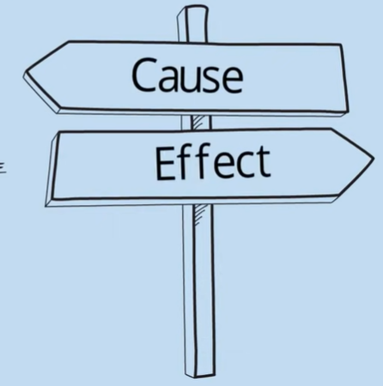
Transition Signals
What are transition signals
words/phrases which signal relationships between ideas
also called linking phrases/sign-post phrases/ cohesive devices
Types:
Cause transitions (for this reason, because of)
Effect transitions (as a result, consequently)
Comparison transitions (similarly, just like)
Contrast transitions (however, whereas)

Slide 13
Transition Signals
Transitions to show:
Examples
Order of importance
Chronological order
List
Addition
Alternatives

Slide 14
Transition Signals
Cohesion is an important feature of academic writing. It can help ensure that your writing coheres or 'sticks together', which will make it easier for the reader to follow the main ideas in your essay or report. You can achieve good cohesion by paying attention to five important features. The first of these is repeated words. The second key feature is reference words. The third one is transition signals. The fourth is substitution. The final important aspect is ellipsis.

Slide 15
Cohesion
Good cohesion is achieved through the following five main methods:
Reference words
Repeated words/ideas
Transition signals
Substitution
Ellipsis

Slide 16
Substitution
Substitutes (i.e. replaces) an earlier word(s) with another
Similar to reference words
For example:
The graph on the left shows average calorie intake by age, which the one on the right shows daily exercise levels.
Drinking alcohol before driving is banned in many countries, since doing so can seriously impair one’s ability to drive safely.

Slide 17
Cohesion
Good cohesion is achieved through the following five main methods:
Reference words
Repeated words/ideas
Transition signals
Substitution
Ellipsis

Slide 18
Ellipses
Leaving out words (because meaning is clear)
Example:
The first graph shows a high calorie intake for 20-25 years old, the first graph shows a lower calorie intake for 25-30 years old, and the first graph shows a very low calorie intake for those over 30.
The first graph shows a high calorie intake for 20-25 years old, a lower intake for 25-30 years old, and a very low for those over 30.

Slide 19
Coherence
Relates to organization and progression of ideas.
Also about how clear and easy the ideas are to understand.

Slide 20
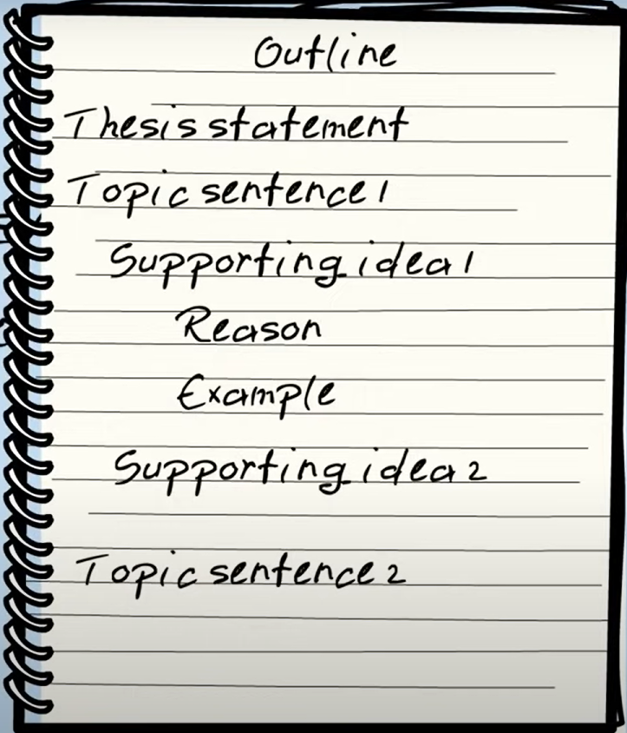
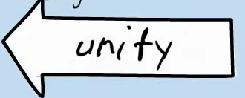
How to improve coherence?
Make sure the ideas are well-organized.
Create an outline before writing
Create a reverse outline after writing
Make sure you have a clear thesis statement, topic sentences, summary.
Check that all ideas in a paragraph relate to the topic sentence.
Check that all the topic sentences relate to the thesis statement.

Slide 21
How to improve coherence?
Make sure ideas can be understood by the reader
Consider the audience
Consider the purpose.
If possible, ask a peer to read it: does it make sense to them? (Peer Editing)

Slide 22
Activity
Consider the provided sample essay, highlight the different cohesive aspects in this essay, i.e. repeated words/ideas, reference words, transition signals, substitution and ellipsis.

